Slide 1
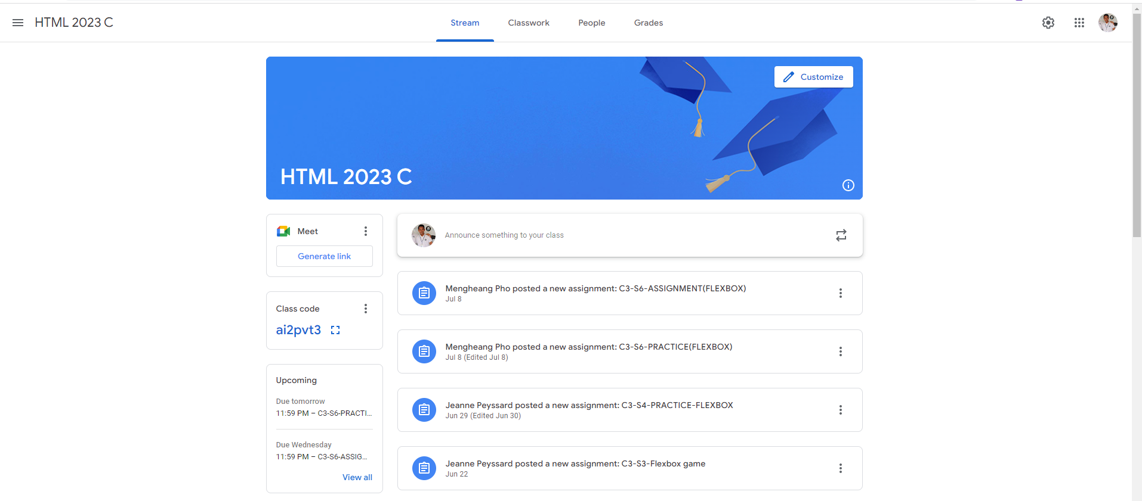
Identify root components of website below

Slide 2
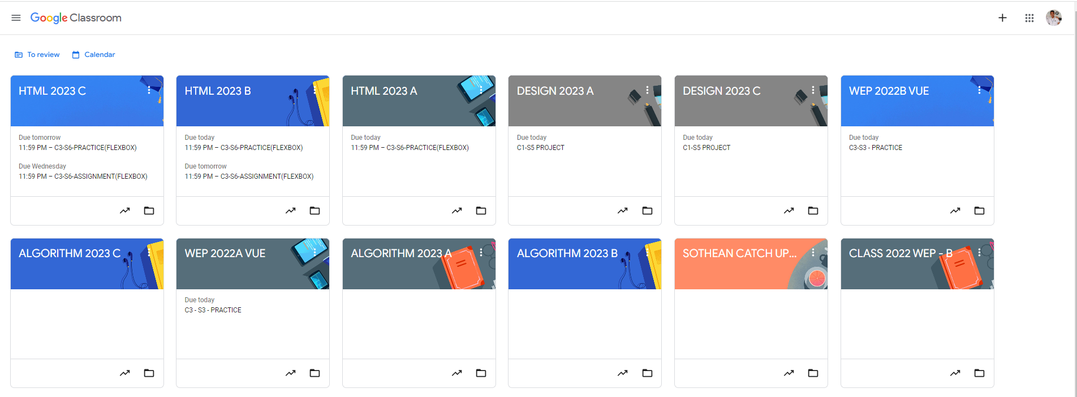
Root div
- Height: 100vh
content
nav
Flex: 0
header
Flex: 0
Flex: 1

Slide 3
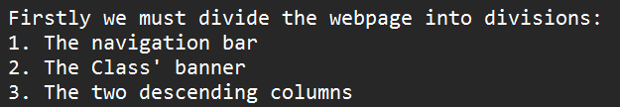

Slide 4
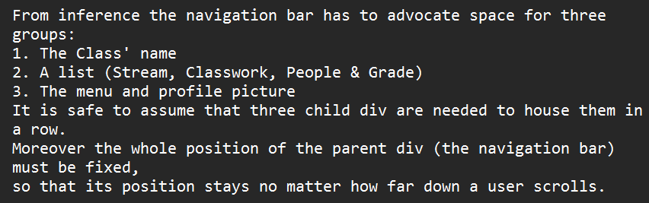

Slide 5
Up next is the Class' logo, which has a smaller div element to contain the Customize button
and another to display the class' name in the opposite corner. As for the image, it is the background image.

Slide 6
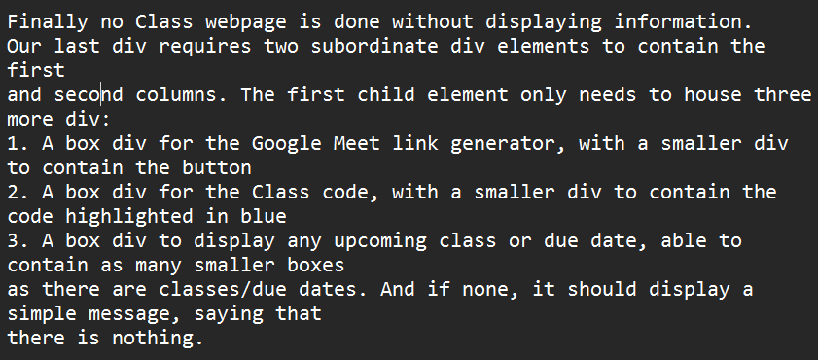

Slide 7
